Slide 1

Application of Machine Learning Techniques for Stock Market Prediction
Team Members:
Mr. Raj Nandan Rai
Mr. Chaitanya Nemali
Mr. Monish Merani

Slide 2
Introduction(Brief on project)
In this project we are going to apply Machine Learning Algorithms for analyzing price patterns with an aim to identify undervalued and overvalued stocks for trading decisions.
Profitable trading calls can be taken with the help of a successful prediction algorithm. If the model predicts the stock to be undervalued, there is a profit to be made by taking a long position (buy) on that stock. Similarly, if the model predicts the stock to be overvalued, profit can still be made by taking a short position (sell) on that stock.

Slide 3
The stock prices are known to be influenced by fundamental, technical and behavioral factors.
These factors are gleaned from data collected from various sources such as corporate results (financial statements and the language/sentiment expressed in management discussion), technical indicators drawn from price and volume data and the market sentiment analysis based on social media buzz.
We are aiming for a model that can integrate core pieces of these multiple factors to arrive at an inference regarding the intrinsic value of a stock. Once a successful model is built, it can be scaled to apply to any number of stocks on which fundamental, technical and a certain level of social media chatter is available.

Slide 4
Deliverables of the project : A model that determines which of the stocks in Nifty 50 index are undervalued and overvalued at a given point of time based on a set of parameters.
Resources: Websites of exchanges, other public sources: Websites (eg: moneycontrol.com, Yahoo Finance, Google Finance, etc) and stock market discussion on social media sites & news feeds.

Slide 5
Milestones & Timelines
Milestones | Start Date | Finish Date | Grading
1. Define a problem | 22-05-2016 | 31-05-2016 | 5%
2. Get the Data | 01-06-2016 | 15-06-2016 | 5%
3. Explore and pre-process data | 16-06-2016 | 30-06-2016 | 10%
4. Create Features | 01-07-2016 | 15-07-2016 | 5%
5. Create Models | 16-07-2016 | 15-08-2016 | 55%
6. Deploy & consume model | 16-08-2016 | 31-08-2016 | 20%
7. Report Writing | 01-09-2016 | 15-09-2016 | 10%
8. Project submission | 16-09-2016 | 30-09-2016 | 15%
9. Final presentation with project/product demonstration | 01-10-2016 | 15-10-2016 | 20%
10. Blog publishing | 16-10-2016 | 21-10-2016 | 5%

Slide 6
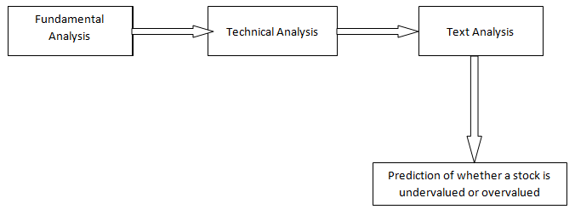
Technical architecture
Fundamental Data: Financial statements and the sentiment of language used in “management discussion” section of the Annual Reports.
Technical Data: Momentum indicators drawn from price and volume data such as Moving Averages, Bollinger Bands, Relative Strength Index (RSI), etc.
Sentiment Data / Text Data: Market sentiment analysis based on social media buzz (stock market discussion on social media sites) and news feeds.

Slide 7
We would like to apply various machine learning algorithms on the stock market data to identify which algorithm/algorithms work best for which stocks.
During this process, we will keep an eye out to identify whether a specific model works best with a particular cluster of stocks (i.e., a specific set of stocks all of which belongs to the same/related industry/sector).
We would like to explore Machine Learning techniques such as Regression, K-nearest neighbors, Decision Trees, Support Vector Machines, Ensemble learners, Bootstrap Aggregating (Bagging) & Boosting and Reinforcement Learning (Markov Decision Problems), Q-Learning (Dyna-Q), etc.
Depending on our abilities and the time constraints, we will be implementing either all or a subset of the algorithms mentioned here.
We will be using Python (Pandas dataframe, NumPy, etc) for this project. Our model will work on static data (not on real-time data). Subsequently, if this is converted into a real-time analysis, we will use Spark with HDFS or other related technology (other tools in Hadoop ecosystem) for that purpose.

Slide 8
THANK YOU!

